Slide 1



INTI6 – Inteligência Artificial
K-Nearest Neighbors (KNN)
Prof. Dr. Samuel Martins (Samuka)
samuel.martins@ifsp.edu.br
https://www.flaticon.com/free-icon/brain_3617186?term=machine%20learning&page=1&position=2&page=1&position=2&related_id=3617186&origin=tag

Slide 2
KNN
One of the simplest (instance-based) classification algorithms.
It works for binary or multiclass problems.
Training Set
10
No
9
Yes
mean grade | wekly study hours | approved at a university?
0.9 | 0.5 | No
2.2 | 2 | No
9.00 | 7.2 | Yes
6.5 | 8.00 | Yes
... | ... | ...
8
7
6
weekly study hours
5
4
3
2
1
0
0
1
2
3
4
5
6
7
8
9
10
mean grade

Slide 3

No Training
10
No
9
Yes
8
7
6
weekly study hours
5
4
  KNN does not learn any model.
3
2
1
0
0
1
2
3
4
5
6
7
8
9
10
mean grade

Slide 4
Classification
10
No
9
Yes
8
7
New test sample
6
weekly study hours
5
4
3
2
1
0
0
1
2
3
4
5
6
7
8
9
10
mean grade

Slide 5
Classification
hyperparameter
Step 1: Choose the number K of neighbors;
10
No
9
Yes
8
7
6
weekly study hours
5
4
k = 3
3
2
1
0
0
1
2
3
4
5
6
7
8
9
10
mean grade

Slide 6
Classification
hyperparameter
Step 1: Choose the number K of neighbors;
Step 2: Take the K nearest neighbors of the new instance, according to a given distance measure (e.g., Euclidean);
10
No
9
Yes
8
7
6
weekly study hours
5
4
k = 3
3
2
1
0
0
1
2
3
4
5
6
7
8
9
10
mean grade

Slide 7
Classification
hyperparameter
Step 1: Choose the number K of neighbors;
Step 2: Take the K nearest neighbors of the new instance, according to a given distance measure (e.g., Euclidean);
Step 3: Among these K neighbors, count the number of training instances in each class/category.
10
No
9
Yes
8
7
6
weekly study hours
5
4
k = 3
3
2
No = 0
Yes = 3
1
0
0
1
2
3
4
5
6
7
8
9
10
mean grade

Slide 8
Classification
hyperparameter
Step 1: Choose the number K of neighbors;
Step 2: Take the K nearest neighbors of the new instance, according to a given distance measure (e.g., Euclidean);
Step 3: Among these K neighbors, count the number of training instances in each class/category.
Step 4: Assign the new test instance to the most frequent class (majority voting).
10
No
9
Yes
8
7
6
Yes
weekly study hours
5
4
k = 3
3
2
No = 0
Yes = 3
1
0
0
1
2
3
4
5
6
7
8
9
10
mean grade

Slide 9
Classification
hyperparameter
Step 1: Choose the number K of neighbors;
Step 2: Take the K nearest neighbors of the new instance, according to a given distance measure (e.g., Euclidean);
Step 3: Among these K neighbors, count the number of training instances in each class/category.
Step 4: Assign the new test instance to the most frequent class (majority voting).
10
No
9
Yes
8
7
6
weekly study hours
5
4
3
2
1
0
0
1
2
3
4
5
6
7
8
9
10
mean grade

Slide 10
Classification
hyperparameter
Step 1: Choose the number K of neighbors;
Step 2: Take the K nearest neighbors of the new instance, according to a given distance measure (e.g., Euclidean);
Step 3: Among these K neighbors, count the number of training instances in each class/category.
Step 4: Assign the new test instance to the most frequent class (majority voting).
10
No
9
Yes
8
7
6
Yes
weekly study hours
5
4
k = 1
3
2
No = 0
Yes = 1
1
0
0
1
2
3
4
5
6
7
8
9
10
mean grade

Slide 11
Classification
hyperparameter
Step 1: Choose the number K of neighbors;
Step 2: Take the K nearest neighbors of the new instance, according to a given distance measure (e.g., Euclidean);
Step 3: Among these K neighbors, count the number of training instances in each class/category.
Step 4: Assign the new test instance to the most frequent class (majority voting).
10
No
9
Yes
8
7
6
No
weekly study hours
5
4
k = 3
3
2
No = 2
Yes = 1
1
0
0
1
2
3
4
5
6
7
8
9
10
mean grade

Slide 12
Classification
hyperparameter
Step 1: Choose the number K of neighbors;
Step 2: Take the K nearest neighbors of the new instance, according to a given distance measure (e.g., Euclidean);
Step 3: Among these K neighbors, count the number of training instances in each class/category.
Step 4: Assign the new test instance to the most frequent class (majority voting).
10
No
9
Yes
8
7
6
No
weekly study hours
5
4
k = 3
3
2
No = 2
Yes = 1
1
0
0
1
2
3
4
5
6
7
8
9
10
mean grade

Slide 13
Common Distance Measures

Slide 14
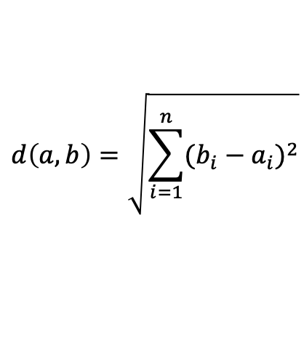
Common Distance Measures
Euclidean
a
b
$$d\left(a,b\right)=\sqrt{\sum_{i=1}^{n}{{(b_{i}−a_{i})}^{2}}}$$
Common distance measure;
Suitable for low-dimensional data;

Slide 15
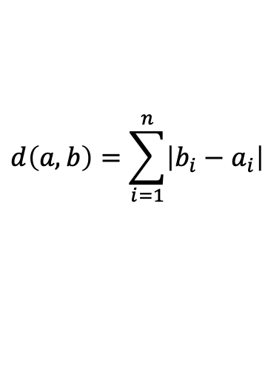
Common Distance Measures
Euclidean
Manhattan
a
a
b
b
$$d\left(a,b\right)=\sqrt{\sum_{i=1}^{n}{{(b_{i}−a_{i})}^{2}}}$$
$$d\left(a,b\right)=\sum_{i=1}^{n}{\left|b_{i}−a_{i}\right|}$$
Common distance measure;
Suitable for low-dimensional data;
Work quite well when your data has discrete and/or binary attributes;
Work ok for high-dimensional data;
Less intuitive than Euclidean distance;
In general, give a higher distance value than Euclidean distance;

Slide 16

Common Distance Measures
Euclidean
Manhattan
Chebyshev
a
a
a
b
b
b
$$d\left(a,b\right)=\sqrt{\sum_{i=1}^{n}{{(b_{i}−a_{i})}^{2}}}$$
$$d\left(a,b\right)=\sum_{i=1}^{n}{\left|b_{i}−a_{i}\right|}$$
$$d\left(a,b\right)=\max_{i}{(\left|b_{i}−a_{i}\right|)}$$
Common distance measure;
Suitable for low-dimensional data;
Work quite well when your data has discrete and/or binary attributes;
Work ok for high-dimensional data;
Less intuitive than Euclidean distance;
In general, give a higher distance value than Euclidean distance;
It can be used to extract the minimum number of moves needed to get from one square to another;
Used in very specific use-cases, such as warehouse logistics;

Slide 17
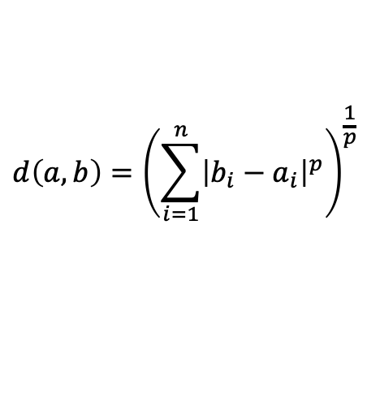
Common Distance Measures
Euclidean
Manhattan
Chebyshev
Minkowski
a
a
a
a
p
b
b
b
b
$$d\left(a,b\right)=\sqrt{\sum_{i=1}^{n}{{(b_{i}−a_{i})}^{2}}}$$
$$d\left(a,b\right)={\left(\sum_{i=1}^{n}{{\left|b_{i}−a_{i}\right|}^{p}}\right)}^{\frac{1}{p}}$$
$$d\left(a,b\right)=\sum_{i=1}^{n}{\left|b_{i}−a_{i}\right|}$$
$$d\left(a,b\right)=\max_{i}{(\left|b_{i}−a_{i}\right|)}$$
Common distance measure;
Suitable for low-dimensional data;
Work quite well when your data has discrete and/or binary attributes;
Work ok for high-dimensional data;
Less intuitive than Euclidean distance;
In general, give a higher distance value than Euclidean distance;
It can be used to extract the minimum number of moves needed to get from one square to another;
Used in very specific use-cases, such as warehouse logistics;
Metric in a normed vector space;
The upside to p is the possibility to iterate over it and find the distance measure that works best for your use case.
p=1 → Manhattan distance
p=2 → Euclidean distance
p=∞ → Chebyshev distance

Slide 18
Common Distance Measures
Euclidean
Manhattan
Chebyshev
Minkowski
a
a
a
a
p
b
b
b
b
$$d\left(a,b\right)=\sqrt{\sum_{i=1}^{n}{{(b_{i}−a_{i})}^{2}}}$$
$$d\left(a,b\right)={\left(\sum_{i=1}^{n}{{\left|b_{i}−a_{i}\right|}^{p}}\right)}^{\frac{1}{p}}$$
$$d\left(a,b\right)=\sum_{i=1}^{n}{\left|b_{i}−a_{i}\right|}$$
$$d\left(a,b\right)=\max_{i}{(\left|b_{i}−a_{i}\right|)}$$
Common distance measure;
Suitable for low-dimensional data;
Work quite well when your data has discrete and/or binary attributes;
Work ok for high-dimensional data;
Less intuitive than Euclidean distance;
In general, give a higher distance value than Euclidean distance;
It can be used to extract the minimum number of moves needed to get from one square to another;
Used in very specific use-cases, such as warehouse logistics;
Metric in a normed vector space;
The upside to p is the possibility to iterate over it and find the distance measure that works best for your use case.
p=1 → Manhattan distance
p=2 → Euclidean distance
p=∞ → Chebyshev distance
  Typically, these metrics require feature scaling.

Slide 19
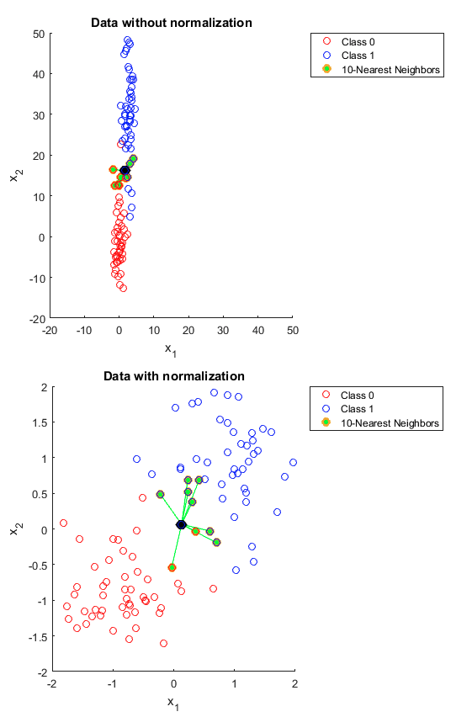
KNN with and without Feature Scaling
Data without Feature Scaling
Data with Feature Scaling
https://machinelearningmastery.com/k-nearest-neighbors-for-machine-learning/#:~:text=KNN%20for%20Classification&text=If%20you%20are%20using%20K,an%20odd%20number%20of%20classes.
  KNN works properly after feature scaling your data.
https://stats.stackexchange.com/a/287439

Slide 20
Choosing the value of K

Slide 21
Choosing the value of K
If K is too small:
  KNN is sensitive to outliers;
  KNN overfits the training data:
    Higher error on different sets;
10
No
9
Yes
8
7
6
weekly study hours
5
4
3
2
1
0
0
1
2
3
4
5
6
7
8
9
10
mean grade

Slide 22
Choosing the value of K
If K is too small:
  KNN is sensitive to outliers;
  KNN overfits the training data:
    Higher error on different sets;
If K is too large:
  Neighbors can include samples from other classes;
  KNN performs poorly on both train and validation set;
10
No
9
Yes
8
7
6
weekly study hours
5
4
3
2
1
0
0
1
2
3
4
5
6
7
8
9
10
mean grade

Slide 23
Choosing the value of K
If K is too small:
  KNN is sensitive to outliers;
  KNN overfits the training data:
    Higher error on different sets;
If K is too large:
  Neighbors can include samples from other classes;
  KNN performs poorly on both train and validation set;
K is a hyperparameter so we can optimize it for our problem;
  For example, by Cross-Validation Grid Search
10
No
9
Yes
8
7
6
weekly study hours
5
4
3
2
1
0
0
1
2
3
4
5
6
7
8
9
10
mean grade

Slide 24
Choosing the value of K
If K is too small:
  KNN is sensitive to outliers;
  KNN overfits the training data:
    Higher error on different sets;
If K is too large:
  Neighbors can include samples from other classes;
  KNN performs poorly on both train and validation set;
K is a hyperparameter so we can optimize it for our problem;
  For example, by Cross-Validation Grid Search
  By plotting an elbow curve
Elbow Curve
Best K
(elbow)
Validation Error
Error
0
0
10
20
30
40
50
K value

Slide 25
KNN: Pros and Cons
Pros
Extremely easy to implement it;
It does not require training;
By not requiring training before making estimation/classifications, new training samples can be added without any problems (no models’ retraining);
There is only a single hyperparameter required by KNN
  Number of neighbors K
  If we consider other distances, we can have more required hyperparameters (Minkowski, ...);

Slide 26
KNN: Pros and Cons
Pros
Extremely easy to implement it;
It does not require training;
By not requiring training before making estimation/classifications, new training samples can be added without any problems (no models’ retraining);
There is only a single hyperparameter required by KNN
  Number of neighbors K
  If we consider other distances, we can have more required hyperparameters (Minkowski, ...);
Cons
It does not work well for high dimensionality data (the curse of dimensionality)
The prediction time can be high if the size of the training set is large;

Slide 27


Variant: KNN Regression
$$y$$
Training sample
$$x_{1}$$

Slide 28
Variant: KNN Regression
The outcome (label / dependent variable) of a new test sample is computed based on the mean of the outcomes/labels of its K nearest neighbors.
$$y$$
Training sample
$$x_{1}$$
k = 3

Slide 29
Variant: KNN Regression
The outcome (label / dependent variable) of a new test sample is computed based on the mean of the outcomes/labels of its K nearest neighbors.
$$y$$
Training sample
$$x_{1}$$
k = 3

Slide 30
Variant: KNN Regression
The outcome (label / dependent variable) of a new test sample is computed based on the mean of the outcomes/labels of its K nearest neighbors.
$$y$$
Training sample
$$x_{1}$$
k = 3

Slide 31
Variant: KNN Regression
The outcome (label / dependent variable) of a new test sample is computed based on the mean of the outcomes/labels of its K nearest neighbors.
$$y$$
Training sample
$$x_{1}$$
k = 3

Slide 32
Aprendizado de Máquina e
Reconhecimento de Padrões
K-Nearest Neighbors (KNN)
Prof. Dr. Samuel Martins (Samuka)
samuel.martins@ifsp.edu.br
https://www.flaticon.com/free-icon/brain_3617186?term=machine%20learning&page=1&position=2&page=1&position=2&related_id=3617186&origin=tag

